Slide 1


Slide 2
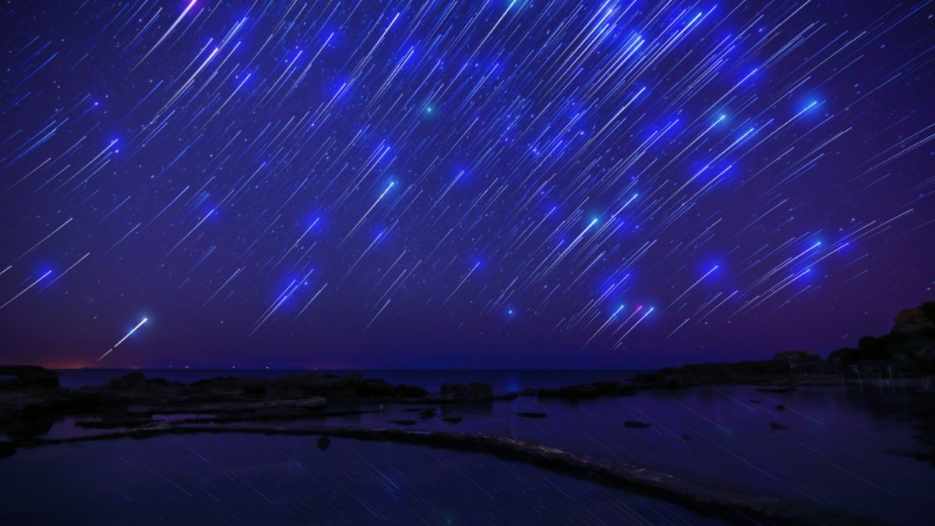
What People Want , It’s a mobile application, there people can share with their wishes and will fulfill someone else’s wishes.

Slide 3



Problem
People do not always realize that what really actually want more.
Lack of selflessness
People closed

Slide 4
Decision
— a mobile application that brings people together to help each other to achieve their desires.
— It allows people to share with their wishes, implement and evaluate other.

Slide 5
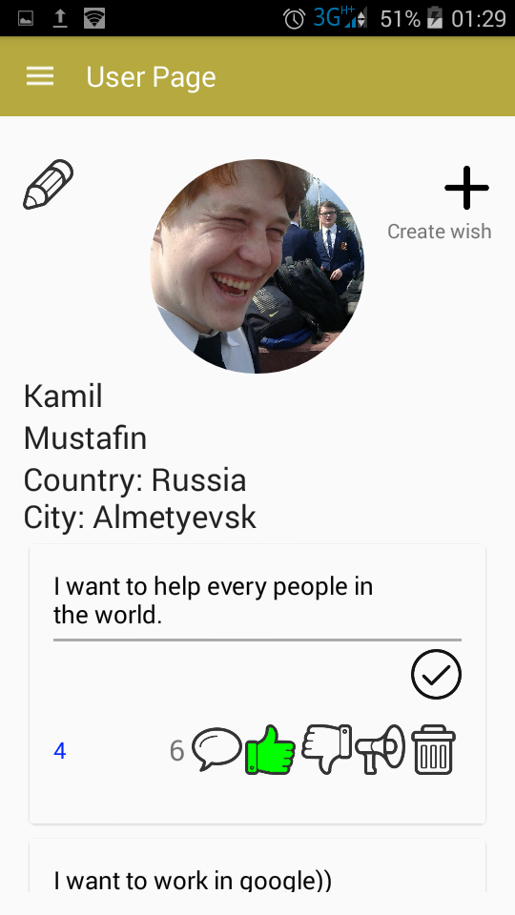
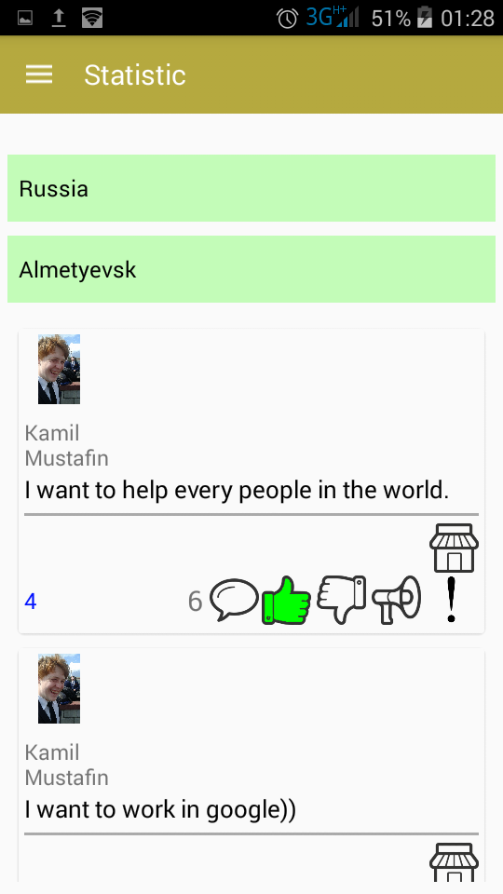
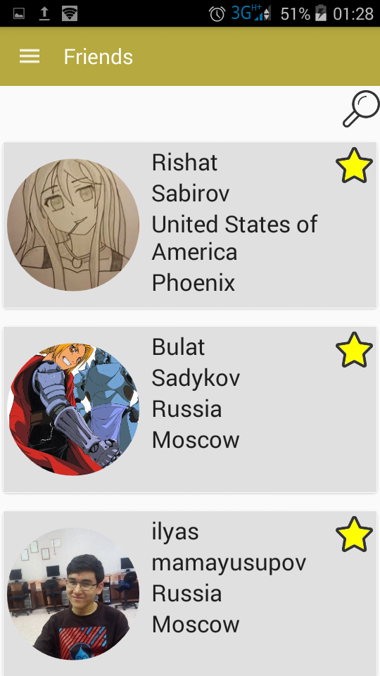
User Page
Statistic
Friends
News

Slide 6
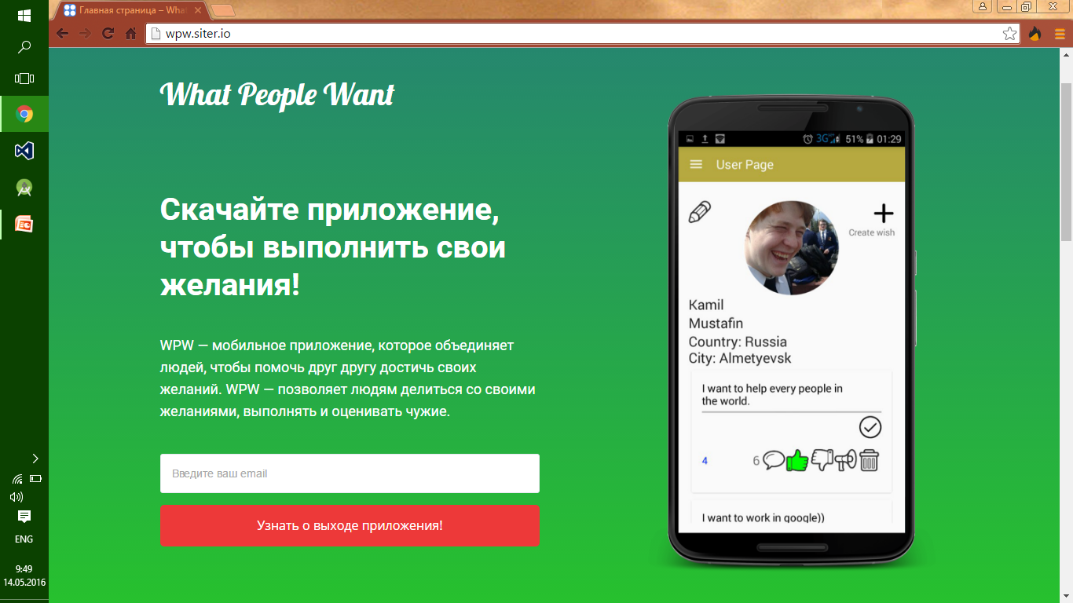
Sell page wpw.siter.io

Slide 7

The target audience of the project
People with smartphones android platform with Internet access.

Slide 8
Monetization model
Standart -First year of using free.
1$/year
Additional services - The desire to become on the first line, regardless of what his rating.
(5$/wish).

Slide 9
Рынок
143,5*0,42*0,368 = 22 млн пользователей android в РФ
143,5*0,42*0,368*0,3 = 6 млн привлечь
100000 пользователей
на первый год.
42% - количество владельцев смартфонов в РФ
К концу 2017 года мы планируем заработать примерно 100000$

Slide 10
Competitors
Type | Examples | OUR ADVANTAGES
Dating websites | Badoo and etc. | We can not only get acquainted with someone.
Websites advertisement | Avito, Ebay and etc. | Desires can be performed selflessly.
Community | Communities in facebook, vk and etc. | We have more functions

Slide 11
Promotion
Advertising on social networking sites(facebook and etc).
Advertisement on youtube channels associated with blogs.
In newspapers(vc.ru and etc).

Slide 12
Summary
Our product in the first place, based on selflessness and how to make people happier by the execution of their desires.

Slide 13
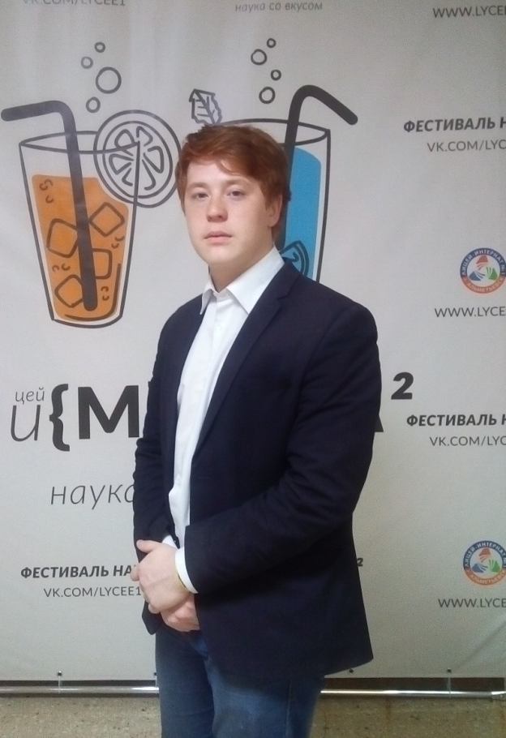
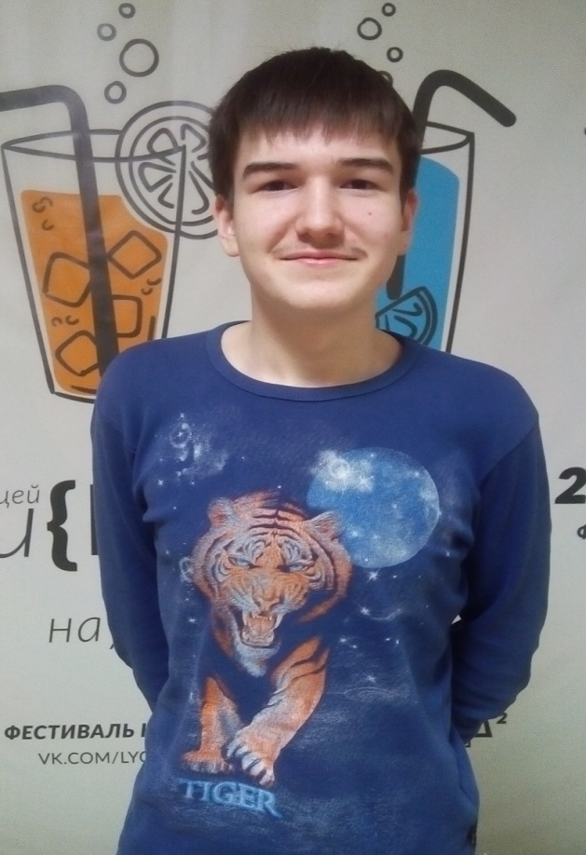
Team
Mustafin Kamil
The project leader, java programmer, designer, creater of application.
Sabirov Rishat Php, MySQL programmer creater of database.

Slide 14
Contact details
Kamil Mustafin 8 (965)-612-85-17
k-mustafin@bk.ru
wpw.siter.io
Thank you!

